Slide 1
CODE CONVERTERS

Slide 2
Code converter – takes an input code, translates to its equivalent output code.
Input
code
Code
converter
Output
code
Example: Binary to Gray code converter
Input: Binary
Output: Gray
Gray to Binary
Input: Gray
Output: Binary
BCD to Excess-3 code converter.
Input: BCD code
Output: Excess-3 code

Slide 3
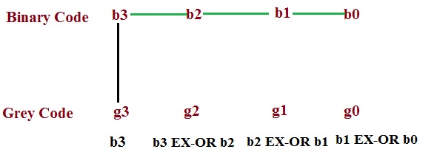
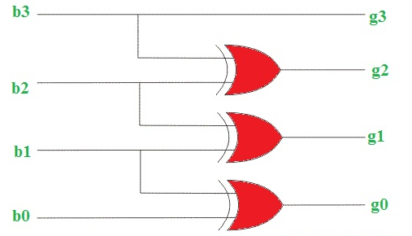
BINARY TO GRAY & GRAY TO BINARY
Binary to Gray
Record the most significant bit as it is.
EX-OR this bit to the next position bit, record the resultant bit.
Record successive EX-ORed bits until completed.
Convert 0011 binary to Gray.
g3 = b3
g2 = b3 xor b2
g1 = b2 xor b1
g0 = b1 xor b0

Slide 4
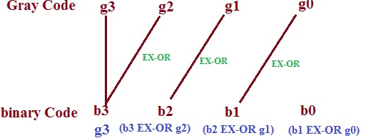
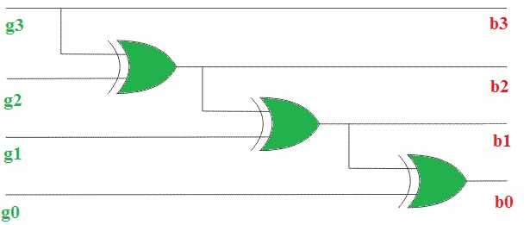
BINARY TO GRAY & GRAY TO BINARY
Gray to Binary
The Gray code can be converted to binary by a reverse process.
Record the most significant bit as it is.
EX-OR binary MSB to the next bit of Gray code and record the resultant bit.
Continue the process until the LSB is recorded.
Convert 1011 Gray to Binary code.
Equations Are:
b3 = g3
b2 = g3 xor g2 or b3 xor g2
b1 = g3 xor g2 xor g1 or b2 xor g1
b0 = g3 xor g2 xor g1 xor g0 or b1 xor g0

Slide 5
BCD-TO-EXCESS-3 CONVERTER
Truth table:
K-maps:
 | BCD |  |  |  | Excess-3
 | A | B | C | D | W | X | Y | Z
0 | 0 | 0 | 0 | 0 | 0 | 0 | 1 | 1
1 | 0 | 0 | 0 | 1 | 0 | 1 | 0 | 0
2 | 0 | 0 | 1 | 0 | 0 | 1 | 0 | 1
3 | 0 | 0 | 1 | 1 | 0 | 1 | 1 | 0
4 | 0 | 1 | 0 | 0 | 0 | 1 | 1 | 1
5 | 0 | 1 | 0 | 1 | 1 | 0 | 0 | 0
6 | 0 | 1 | 1 | 0 | 1 | 0 | 0 | 1
7 | 0 | 1 | 1 | 1 | 1 | 0 | 1 | 0
8 | 1 | 0 | 0 | 0 | 1 | 0 | 1 | 1
9 | 1 | 0 | 0 | 1 | 1 | 1 | 0 | 0
10 | 1 | 0 | 1 | 0 | X | X | X | X
11 | 1 | 0 | 1 | 1 | X | X | X | X
12 | 1 | 1 | 0 | 0 | X | X | X | X
13 | 1 | 1 | 0 | 1 | X | X | X | X
14 | 1 | 1 | 1 | 0 | X | X | X | X
15 | 1 | 1 | 1 | 1 | X | X | X | X
CD
C
CD
C
AB
00 01 11 10
AB
00 01 11 10
00
01
11
10
00
01
11
10
1
1
1
1
1
1
1
B
B
A
X
X
X
X
A
X
X
X
X
1
1
X
X
1
X
X
W
D
X
D
CD
C
CD
C
AB
00 01 11 10
AB
00 01 11 10
00
01
11
10
1
1
00
01
11
10
1
1
1
1
1
1
B
B
A
X
X
X
X
A
X
X
X
X
1
X
X
1
X
X
Y
D
Z
D

Slide 6
BCD-TO-EXCESS-3 CONVERTER
CD
C
CD
C
AB
00 01 11 10
AB
00 01 11 10
W = ?
X = ?
Y = ?
Z = ?
00
01
11
10
00
01
11
10
1
1
1
1
1
1
1
B
B
A
X
X
X
X
A
X
X
X
X
1
1
X
X
1
X
X
W
D
X
D
CD
C
CD
C
AB
00 01 11 10
AB
00 01 11 10
00
01
11
10
1
1
00
01
11
10
1
1
1
1
1
1
B
B
A
X
X
X
X
A
X
X
X
X
1
X
X
1
X
X
Y
D
Z
D


